Slide 1
LEC-7
Introduction to Keras
Basic Code
Keras Datasets

Slide 2
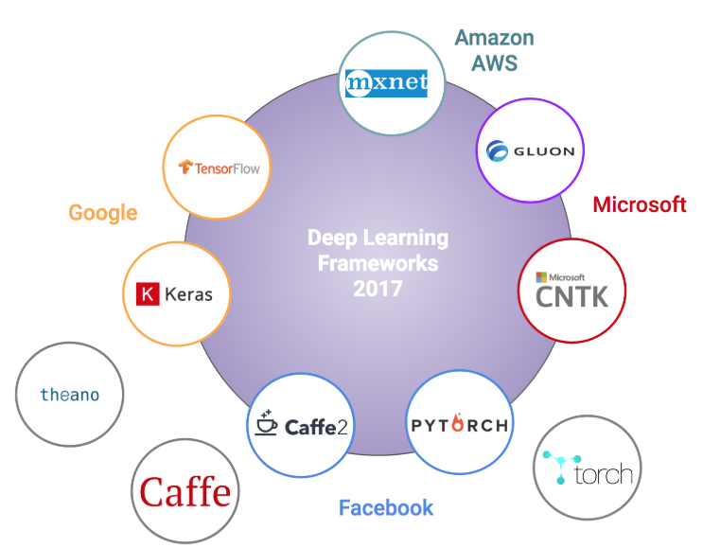
DEEP LEARNING FRAMEWORKS
ON CLOUDS
AMAZON - MXNET
MICROSOFT - CNTK
GOOGLE - TENSORFLOW
FACEBOOK – PYTORCH/CAFFE
OTHERS - THEANO

Slide 3

Keras is an open-source neural-network library
Keras is a high-level neural networks API,
written in Python and
capable of running on top of TensorFlow, CNTK, or Theano.
It was developed with a focus on enabling fast experimentation.
_________________________
Allows for easy and fast prototyping
(through user friendliness, modularity, and extensibility).

Slide 4
means horn in Greek
_________________________
keras was initially developed as part of the research effort of project :
ONEIROS (Open-ended Neuro-Electronic Intelligent Robot Operating System).
----------------------------
Supports both CNN and RNN networks, as well as combinations of the two AND others
Runs seamlessly on CPU and GPU

Slide 5
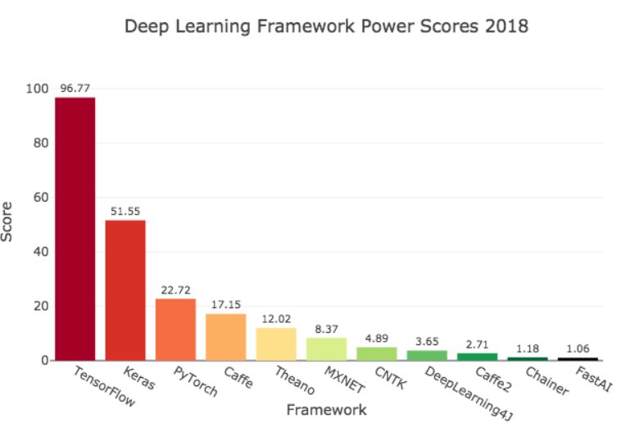
Why keras
Tensorflow
Keras
Pytorch
Cafee
Theano
Mxnet
Cntk
DL4J
Caffe2

Slide 6
BASIC CODE / MODEL
MODEL TYPE model = Sequential()
2. ADD LAYERS model.add(Dense(units=10, activation='softmax')
3. COMPILE model.compile(loss='categorical_crossentropy', optimizer='sgd', metrics=['accuracy'])
4. FIT/TRAIN model.fit(x_train, y_train, epochs=5)
5. EVALUATE model.evaluate(x_test, y_test)
6. PREDICT model.predict(x_test)

Slide 7
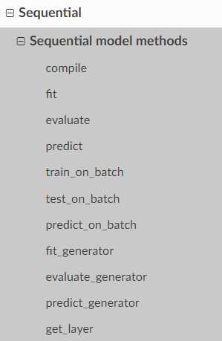
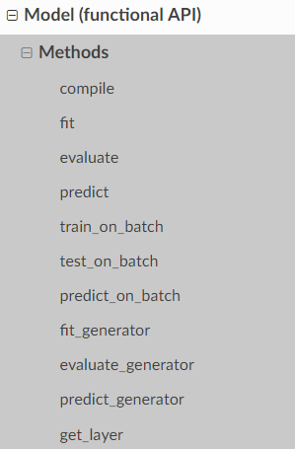
1. Model types
1. SEQUENTIAL
2. FUNCTIONAL
Common elements:
Model.layers,
Model.input
Model.output
Model.summary
Model.get_config
Model.get_weights
Model.set_weights
Model.to_json
Model.to_yaml

Slide 8
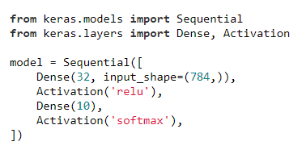
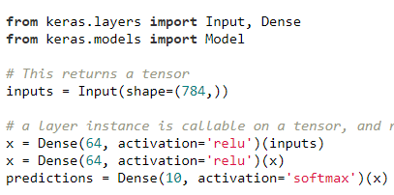

1. SEQUENTIAL 2. FUNCTIONAL

Slide 9
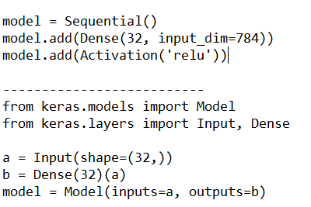
1. SEQUENTIAL 2. FUNCTIONAL

Slide 10
WHAT TO LEARN?
KERAS DATASETS
  CIFAR10/100, IMDB, Reuters, Mnist, Fashion Mnist, Boston Housing
KERAS LAYERS
  Convolution, Pooling, Recurrent, Embedding, merge, Noise
KERAS PREPROCSESING
  Sequence, Image, text
HYPER PARAMETERS
  Optimizer, Activation, Loss Functions
KERAS EXAMPLES CNN
  CNN, RNN, LSTM, GAN etc
4. APPLICATIONS
Xception, VGG16, ResNet, Inception, DenseNet, etc

Slide 11
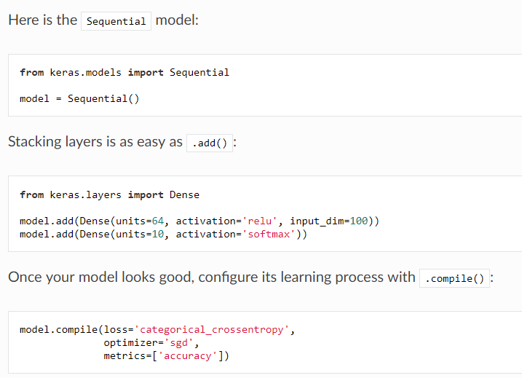
FIRST CODE

Slide 12
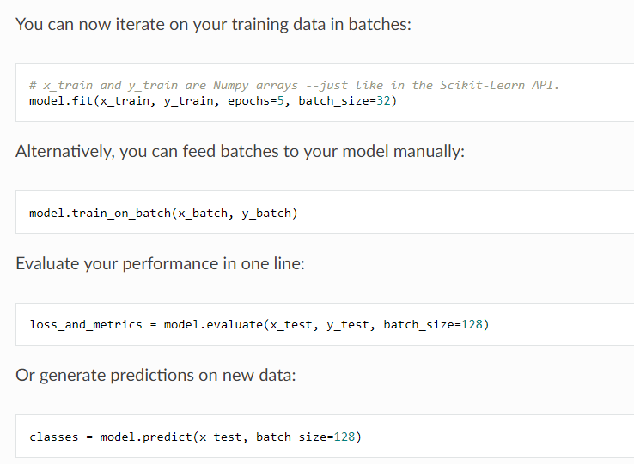

Slide 13
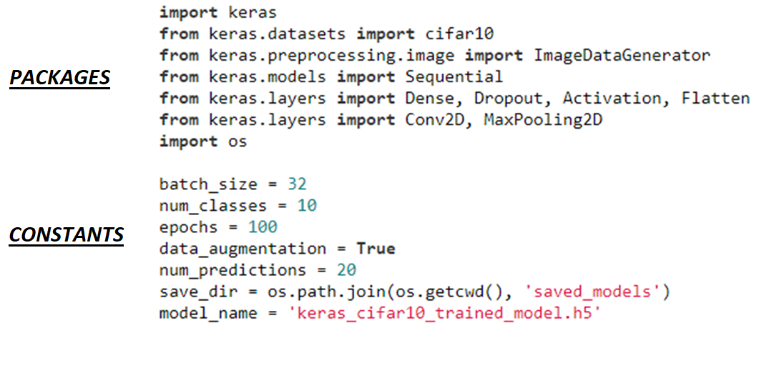
SECOND EXAMPLE
https://keras.io/examples/cifar10_cnn/

Slide 14
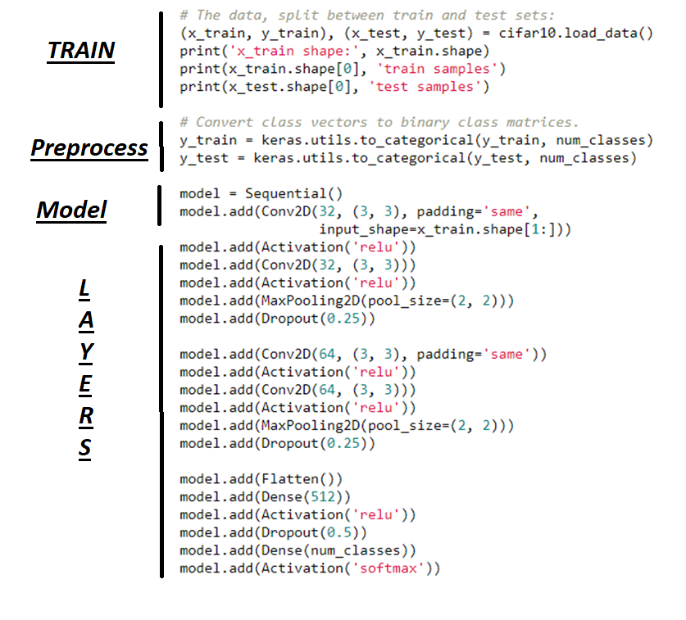

Slide 15
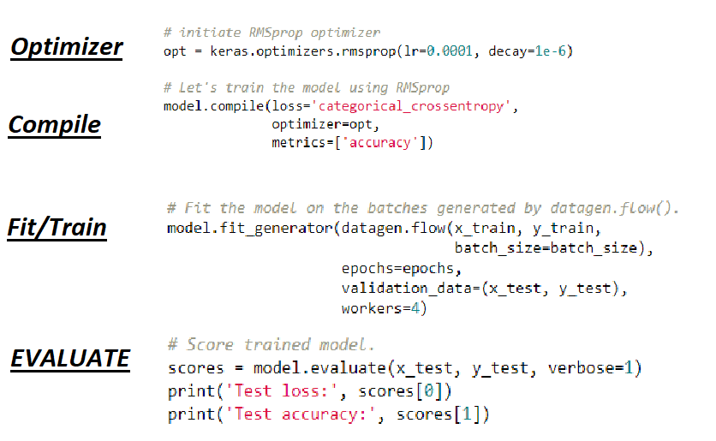

Slide 16
NEXT STEP

